Slide 1
COMPOSITION

Slide 2
What is it?
“The act of composing a written text”

Slide 3
2 major problems before/while writing
Writer’s Block
Lack of Information

Slide 4
THE PROCESS OF WRITING
1.The Topic
2.The Purpose
3.Audience
4.Tone

Slide 5
1.UNDERSTANDING THE TOPIC
It refers to the clear interpretation.
It doesn’t work with guesses.
(follow the activity on page 107)

Slide 6
2. Purpose of Writing
It refers to the aim behind writing.
Aim such as,
To persuade
To inform
To describe
To narrate
To compare and contrast
To analyze
To evaluate

Slide 7
Proceed to activity on page 109

Slide 8
3.Audience
Who are your audience?
Clarity about the reader
Its understanding will help in the selection of tone, vocabulary, style, and attitude.
Activity on page 111

Slide 9
4. Planning
Writing is considered as the construction of something, mainly an idea, school of thought.
Planning a write-up takes time.

Slide 10
Planning should be done as follows,
1. Brainstorming
2. Clustering
3. Free writing
4. Discussion

Slide 11
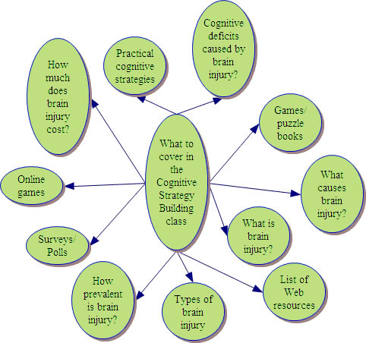
1. Brainstorming
Refers to the intense and free thinking
You jot down random ideas
You do not worry about the importance or relevance of the idea
You scan your brain for ideas
It is done in groups

Slide 12
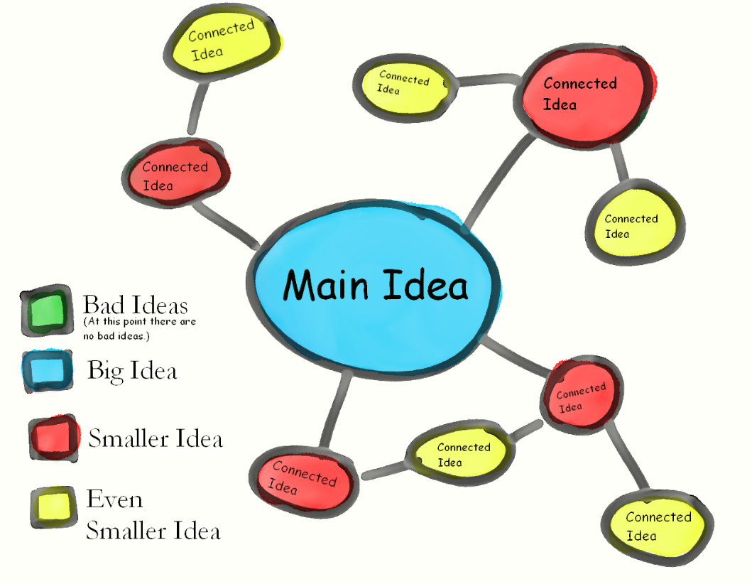
2.Clustering
Similar to brainstorming but different in three ways
It is specific
It is not done in groups
More focused

Slide 13
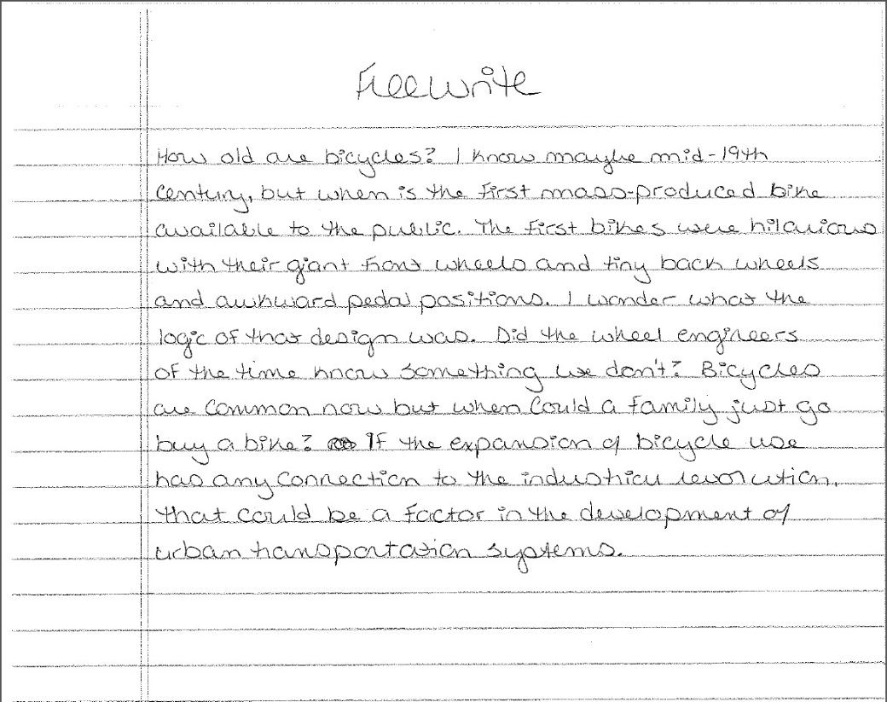
3. Freewriting
This involves continuous writing
Spelling, vocabulary and grammar is not the concern here
Structured as compare to brainstorming and clustering

Slide 14

4. Discussion
Discussion helps in generating ideas

Slide 15
Activity on page 116

